Slide 1
Smart Restaurant Food Ordering Menu using Beaglebone Black
Group Members :-
Amit Kumar (C0772515)
Ashok Kumar (C0762216)
Komalpreet Kaur (C0765526)
Ramandeep Kaur (C0772741)
Sagar Pasricha (C0765531)
Virender Singh (C0762540)
Notes:
<number>

Slide 2
Zero PCB Implementation of Receiver Side
Submitted by:- Virender Singh
( C0762540)
Notes:
<number>

Slide 3
Table of Contents
Block Diagram of receiver side
Components and protocols used
Interfacing Diagram and Pin Diagram
Final Schematics Diagram
PCB and PCB Implementation
Soldering
Testing of PCB after Soldering
Notes:
<number>

Slide 4
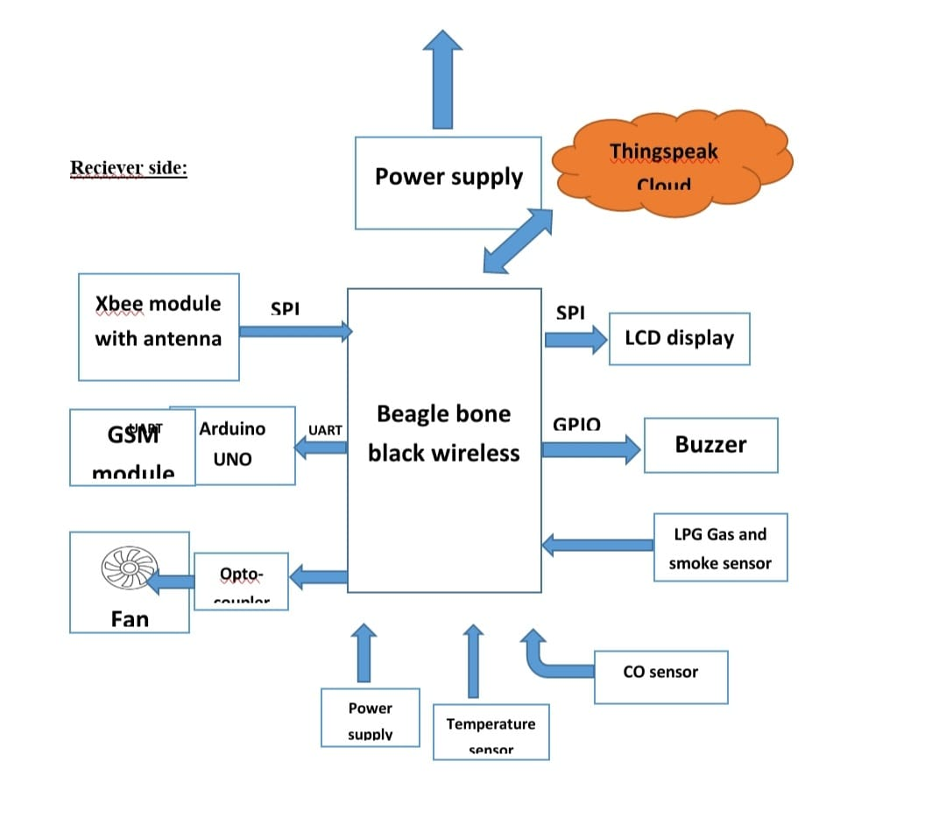
Block Diagram of Receiver Side
Notes:
<number>

Slide 5
Components and Communication Protocol Used
Components used at Receiver Side :-
Beaglebone Black Wireless, Xbee Module, GSM Module, Arduino, Fan, Optocoupler, Temperature Sensor, CO Sensorr, LPG Gas and Smoke Sensor, LCD Display, Buzzer
Communication Protocol Used :- UART
Notes:
<number>

Slide 6
Xbee S2C Module
Xbee S2C module is a RF module rhat has been designed for the wireless communication or the data exchange and it works on the Zigbee mesh communication protocols.
Basically this module provides the wireless connectivity to the end point devices in any Xbee mesh networks including devices from the other vendors.
Notes:
<number>

Slide 7
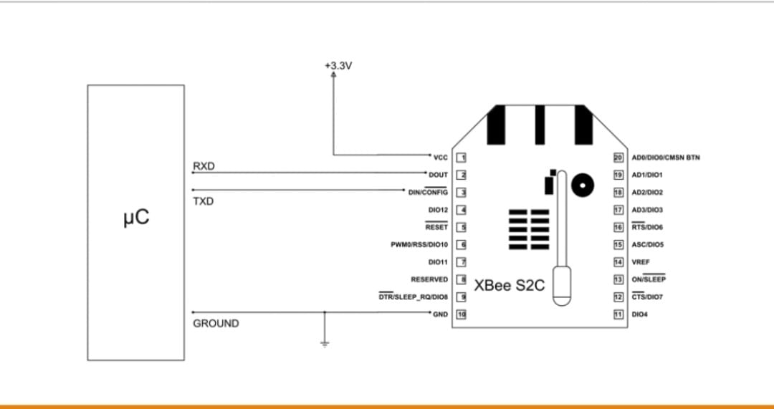
Interfacing of Xbee module with Beaglebone
Notes:
<number>

Slide 8
Interfacing of Xbee module with Beaglebone
Connect pin1(Vcc) of Xbee to pin 4 (Vdd) of BBB wireless (P9 Header)
Connect Pin 10(GND) of Xbee to pin 46 (GND) of BBB wireless (P9 Header)
Connect Pin 2(Dout) of Xbee to pin 26 (UART1_Rx) of BBB wireless (P9) header
Connect pin 3 (Din) of Xbee to pin 24 (UART_1Tx) of BBB wireless (P9 header)
Notes:
<number>

Slide 9
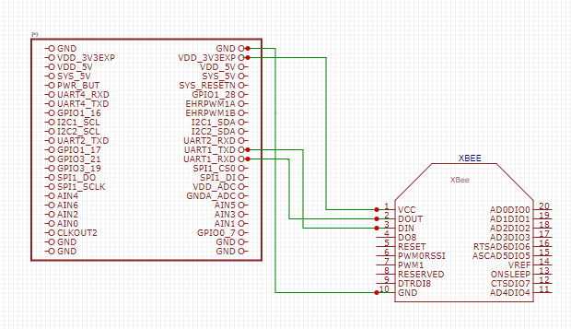
Interfacing of Xbee Module with Beaglebone
Notes:
<number>

Slide 10
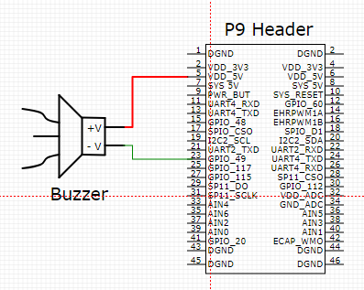
Interfacing of Buzzer with Beaglebone Black Wireless
Red wire(+ve) of buzzer connected to 23rd pin(GPIO_49) of P9 header of BB-WI.
Black wire(Ground) of buzzer connected to 1st pin(DGND) of P9 header of BB-WI.
Notes:
<number>

Slide 11
MQ 2 Sensor
MQ2 gas sensor is an electronic sensor used for sensing the concentration of gases in the air such as LPG, propane, methane, hydrogen, alcohol ,smoke and carbon monoxide.
Notes:
<number>

Slide 12
Interfacing of MQ 2 sensor with BB-WI
BB-WI(P9 Header) | MQ 2 Sensor
1(DGND) | GND
5(VDD 5V) | Vcc
33 (AIN4) | Vout
Notes:
<number>

Slide 13
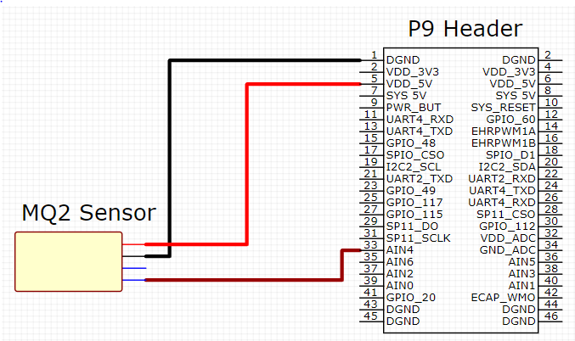
Interfacing of MQ 2 sensor with BB-WI
Notes:
<number>

Slide 14
MQ 9 Sensor
A gas sensor is a device which detects the presence or concentration of gases in the atmosphere. Based on the concentration of the gas the sensor produces a corresponding potential difference by changing the resistance of the material inside the sensor, which can be measured as output voltage. Based on this voltage value the type and concentration of the gas can be estimated.
Notes:
<number>

Slide 15
Interfacing of MQ 9 sensor with BB-WI
BB-WI(P9 Header) | MQ 9 Sensor
2 (DGND) | GND
6 (VDD 5V) | Vcc
36 (AIN5) | Vout
Notes:
<number>

Slide 16
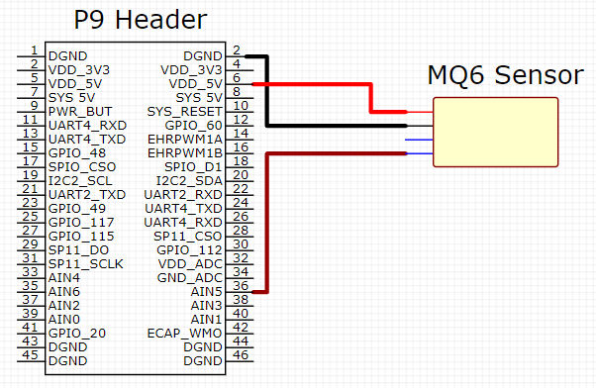
Interfacing of MQ 9 sensor with BB-WI
Notes:
<number>

Slide 17
Temperature Sensor
LM35 is an analog sensor (Temperature Sensor) which measures the temperature and linear output given in voltage form. ADC is required to convert analog output of temperature sensor to digital output. Since BBB has an on chip ADC, we can directly interface these two.
Notes:
<number>

Slide 18
Interfacing of Temperature sensor with BB-WI
Temperature Sensor | BB-WI (P9 Header)
GND | 1 (DGND)
Vcc | 5 (VDD 5V)
Vout | 38 (AIN3)
Notes:
<number>

Slide 19
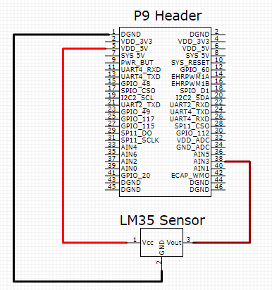
Interfacing of Temperature sensor with BB-WI
Notes:
<number>

Slide 20
MCT2E Opto-coupler
MCT2E is a phototransistor Optocoupler, as the name “phototransistor” suggests it has a transistor which is controlled based on light (photon).this IC basically has an IR (infrared) LED and a photo-transistor inside it. When the IR led is powered the light from it falls on the transistor and it conducts.A
Notes:
<number>

Slide 21
Interfacing of MCT2E Optocoupler with BB-WI
Pin no 1 of MCT2E with gpio_67 pin 8 of P8 header of Beagle bone black wireless.
Pin no 2 of MCT2E with DGND pin 1/2 of P9 header of Beagle bone black wireless.
Pin no 4 of MCT2E with GND of Breadboard
Pin no 5 of MCT2E with positive (red wire) of DC fan.
Notes:
<number>

Slide 22
LCD Display(20*4)
LCD stands for Liquid Crystal Display. It is basically a screen that is used as an electric display module which has various range of applications. Most commonly used module is 16*2 LCD display and it is used in various devices and circuits. But we are using 20*4 LCD Display for this project. These modules are preferred over seven segments and other multi segment LEDs. It is basically available in electronic visible display, video display and flat panel display
Notes:
<number>

Slide 23
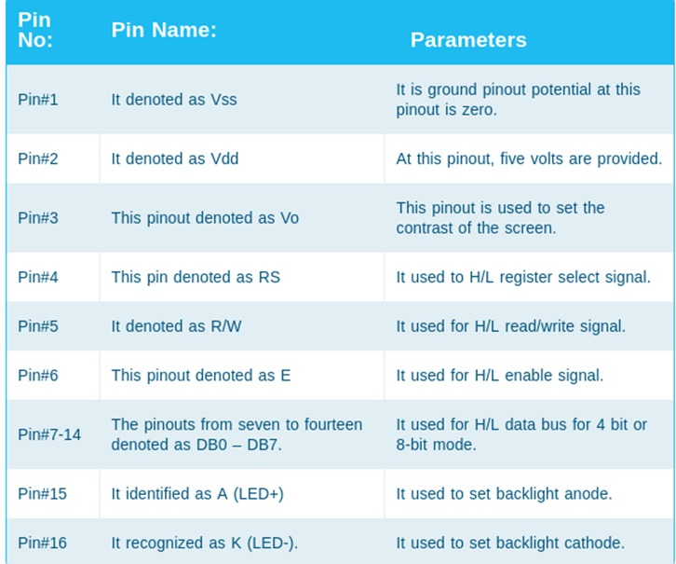
Pin Description of LCD Display
Notes:
<number>

Slide 24
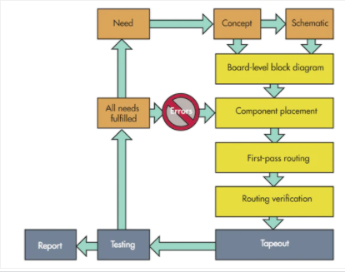
The Basic PCB Design Process:
It includes the design’s features, the functions the PCB must have and perform, interconnection with other circuits, placement, and the approximate final dimensions.
The ideal PCB design flow begins when designers recognize a need that must be fulfilled, and it doesn’t end until testing verifies that the design can meet those needs.
Notes:
<number>

Slide 25
Gerber file:
The Gerber file set is PCB jargon for the output files of the layout that are used by PCB manufacturers to create the PCB. A complete set of Gerber files includes output files generated from the board layout file:
Silkscreen top and bottom
Solder mask top and bottom
All metal layers
Component map (X-Y coordinates)
Assembly drawing top and bottom
Drill file
Drill legend
FAB outline (dimensions, special features)
Netlist file
Notes:
<number>

Slide 26
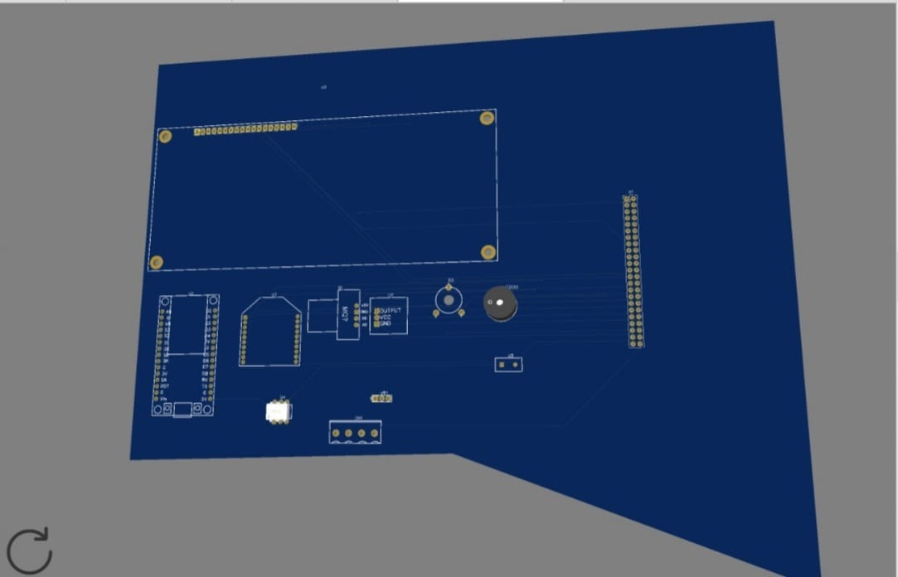
PCB Design Top layer:
Notes:
<number>

Slide 27
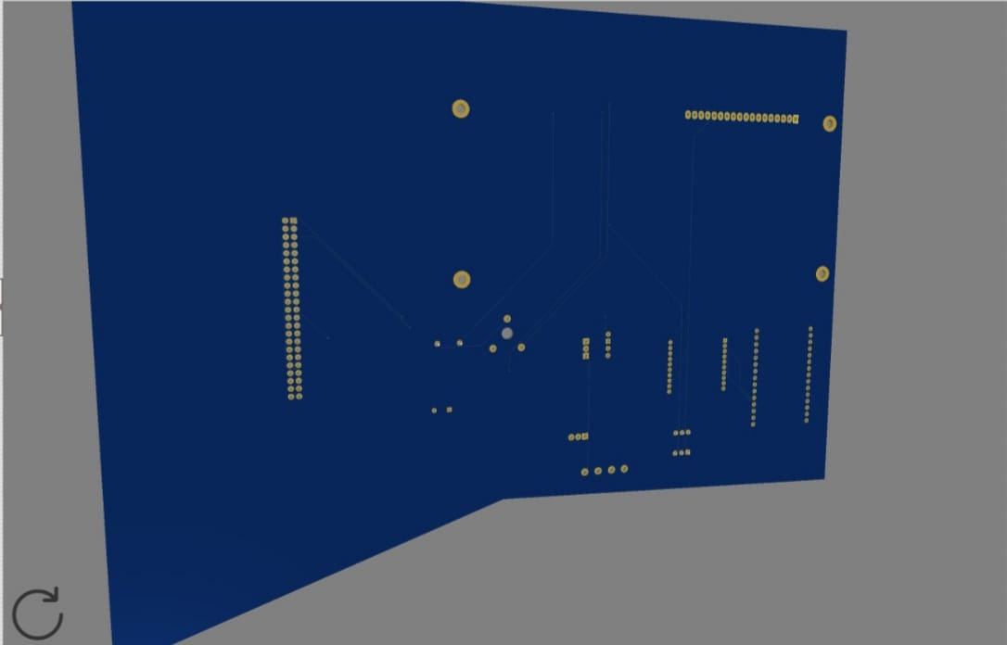
PCB Design Bottom layer:
Notes:
<number>

Slide 28
What is PCB (Printed Circuit Board)
PCB holds all the electrical components mechanically & connects them using conductive pads, tracks & other allied features.
PCBs are primarily categorized based on the method of construction for example:
Single-Sided PCBs, Double-Sided PCBs, Multilayer PCBs& more
Notes:
<number>

Slide 29
Types of PCB:
Single-Sided PCBs
Double-Sided PCBs
Multilayer PCBs
Rigid PCBs
Flex PCBs
Rigid-Flex PCBs
Zero PCB(General purpose PCB)
Notes:
<number>

Slide 30
Zero PCBs
Zero PCB is basically a general-purpose printed circuit board (PCB), also known as perfboard or DOT PCB.
It is a thin rigid copper sheet with holes pre-drilled at standard intervals across a grid with 2.54mm (0.1-inch) spacing between holes.
Each hole is encircled by a round or square copper pad so that component lead can be inserted into the hole and soldered around the pad without short-circuiting the nearby pads and other leads.
For connecting the lead of component with another lead, we solder these together or join these using a suitable conducting wire.
Notes:
<number>

Slide 31
Soldering:
For soldering we require:
Soldering Lead
Soldering Iron
Flux along with a printed circuit board and layout diagram of the circuit.
Notes:
<number>

Slide 32
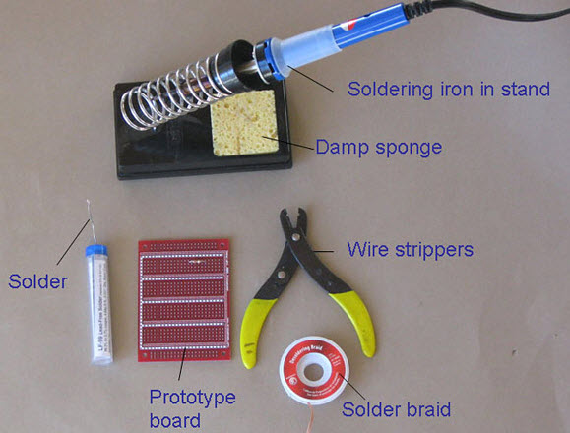
Soldering
Notes:
<number>

Slide 33
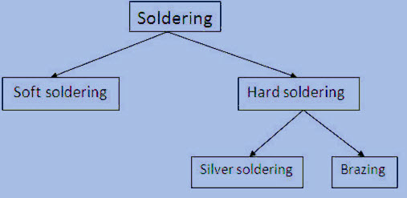
Types of soldering
Notes:
<number>

Slide 34
Soldering iron:
Soldering iron is the required primary thing, which is used as a heat source for liquefying solder.
15W to 30W soldering guns are good for the majority of electronics or PCB (printed circuit board) jobs.
The major difference between a gun and an iron is that iron seems like a pencil and comprises of a pin-point heat supply for the precise job, whereas a gun is like a gun in shape with a high wattage point excited by running electrical current simple through it.
Notes:
<number>

Slide 35
Soldering Process:
Start with the small components to the taller components and connecting wires
Place the element into the PCB, making sure it goes in the correct way around and twist the leads a little to secure the part.
Make sure the soldering iron has warmed up and if required, use the moist sponge to clean the tip.
Place the soldering iron on the component of the pad and feed the solder’s end onto the board
Take away the solder and the soldering iron from the board and leave the terminal to cool for a few seconds.
Using a couple of cutters neat the excess component terminal
If you make a mistake while heat up the joint with the iron, place the solder tip of your solder extractor and push the button.
aa
Notes:
<number>

Slide 36
PCB Testing
A continuity test tells us whether two things are electrically connected,if something is continuous, an electric current can flow freely from one end to the other.
To begin, make sure no current is running through the circuit or component we want to test. Switch it off, unplug it from the wall, and remove any batteries.
Plug the black probe into the COM port on your multimeter.
Plug the red probe into the VΩmA port.
Switch on the multimeter, and set the dial to continuity mode
Notes:
<number>

Slide 37
Testing Continuity:
The multimeter tests continuity by sending a little current through one probe, and checking whether the other probe receives it.
If the probes are connected—either by a continuous circuit, or by touching each other directly—the test current flows through. The screen displays a value of zero (or near zero), and the multimeter beeps.
If the test current isn't detected, it means there's no continuity. The screen will display 1 or OL (open loop).
To complete continuity test, place one probe at each end of the circuit or component we want to test.
Notes:
<number>

Slide 38
Testing Continuity:
If multimeter doesn't have a dedicated continuity test mode, we can still perform a continuity test.
Turn the dial to the lowest setting in the resistance mode.
If the probes are connected—either by a continuous circuit, or by touching each other directly—the test current flows through. The screen displays a value of zero (or near zero—in this case, 0.8). Very low resistance is another way of saying that we have continuity.
If no current is detected, it means there's no continuity. The screen will display 1 or OL (open loop).
Notes:
<number>

Slide 39
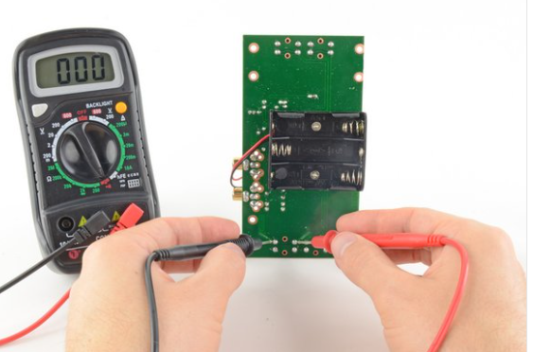
Testing Continuity
Notes:
<number>

Slide 40
Testing Voltage:
Set the dial to DC voltage mode.
Set the correct range for voltage.
Place the red probe on the positive terminal, and the black probe on the negative terminal.
With the range set correctly, we get an accurate reading.
Notes:
<number>

Slide 41
Refrences
Types of PCB’s –retrieved from:
https://www.crimpcircuits.com/blog/types-of-printed-circuit-boards/
Zero PCB –retrieved from:
https://www.electronicsforu.com/technology-trends/learn-electronics/veroboard-zero-pcb-difference#:~:text=Zero%20PCB%20is%20basically%20a,%2Dinch)%20spacing%20between%20holes.
PCB design process:
https://www.electronicdesign.com/technologies/embedded-revolution/article/21798594/the-engineers-guide-to-highquality-pcb-design
Notes:
<number>

Slide 42
Refrences
Refrence for the Interfacing of the components on the receiver side retrieved from
https://github.com/komalkaurr/Group_3_Winter-2021/tree/main/PCB%20designing%20of%20reciever%20side
https://multimeterexpert.com/use-multimeter-test-solder-joint/
Notes:
<number>

